Slide 1
Recruiting in the State Personnel Management System
G. Mark Townend
Director, Recruitment and Examination Division
Department of Budget and Management
September 5, 2023

Slide 2
STATUTORY REQUIREMENTS: Recruiting Process, Timelines, and Postings
The process for recruiting is defined in the State Personnel and Pensions (SPP) article 7 - Employment in the State Personnel Management System, and further defined in Code of Maryland Regulations (COMAR) Title 17, Subtitle 4 - Personnel Services and Benefits
In addition, agencies have policies and practices specific to their specific needs and positions. Policies are not required to be codified and can vary between agencies.

Slide 3
STAKEHOLDERS IN THE STATE HIRING PROCESS
Job Seekers
Current State Employees (promotional)
Agencies and the Administration
Representation (Unions)
State and Federal Equal Employment Opportunity
The Maryland Commission for Civil Rights
The People of Maryland

Slide 4
HIRING GOALS
Governor’s goal to ensure that we can support the needs of the public
Executive Branch agencies have a high-quality workforce that reflects the diversity of the State
Ensure a fair, equitable, and inclusive hiring process free of artificial barriers and bias.

Slide 5
REQUIRED RECRUITING PROCESS FOR SPMS MERIT POSITIONS
The current process takes an average of 130 days:
Job vacated
Review Classification and Job Description (14 days)
Approval to recruit (14 days)
Create selection plan, submit to DBM (10 days)
Post for 2 weeks (14 days)
Applicant rating, points, band score (7 days)
Resolve discrepancies (3 days)
Create the eligible list (1 day)
Notify applicants of their standing (3 days)
Schedule interviews or written test (21 days)
Interviews, or test and score applicants (7 days)
Verify qualifications/background checks (14 days)
Salary negotiation and offer letter (7 days)
Start date (acceptance and notice to current employer - 15 days)

Slide 6
POSTING REQUIREMENTS
Agencies must notify DBM one week prior to posting a job.
Maryland has a statutory 2 week posting requirement.
Extensive information is required in statute.
Required fields include hiring department, date opened, filing deadline, salary, employment type, work location, grade, location of position, job description, minimum qualifications, desired/preferred qualifications, license, registrations and certs, selection process, and further instructions.

Slide 7
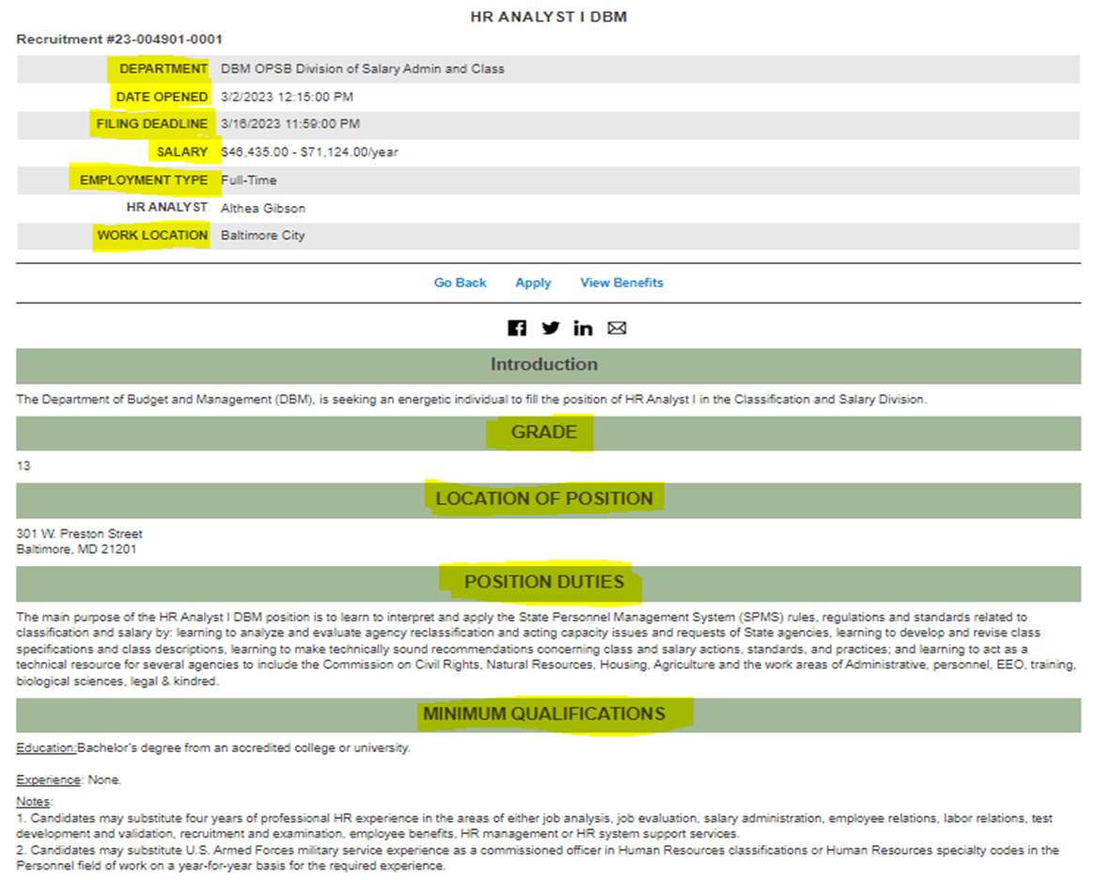
Sample Announcement
Required fields:
- Department
- Date opened
- Filing deadline
- Salary
- Employment type
- Work location
- Grade
- Location of position
- Main purpose/job description
- Minimum qualifications

Slide 8
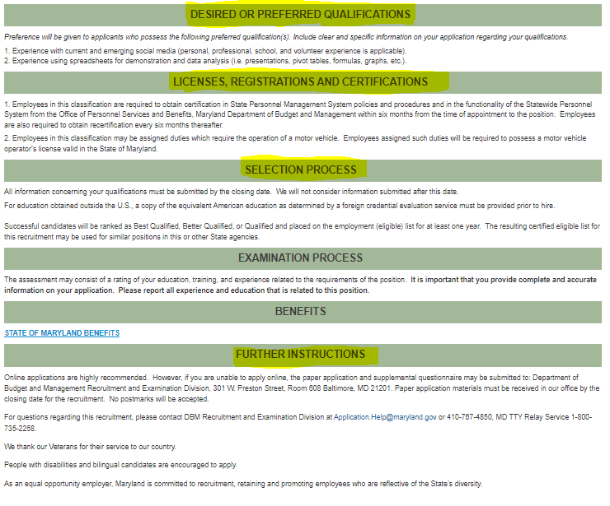
Sample Announcement (continued)
Required fields:
- Desired/preferred qualifications
- Required licenses, registrations and certifications
- Selection process
- Further instructions (includes all required statements, contacts and

Slide 9
DBM AUDIT
DBM conducts an audit of SPMS hiring to ensure that laws, regulations and policies are followed by agencies when performing their hiring.
By statute, DBM must audit agency hiring practices at least once every 3 years. The DBM audit is currently conducted each year.
Each audit uses a random sample of PINs from the prior fiscal year based on each agencies hiring volume.

Slide 10
Summary
Statute requires centralized involvement and a restrictive process for hiring and job posting that increases recruitment timelines.
The required steps for SPMS agencies to hire take an average of 130 days
The state’s job postings are required to contain an excessive amount of information.

Slide 11
Possible Improvements
Repeal posting time requirements to give the State the capability to move quickly to fill positions, like the private sector
Eliminate required notification timelines. They are not necessary.
Repeal job announcement requirements. Applicants are provided with a job description on interview that has the same information. Shorter announcements are used by our private sector competition.

Slide 12
References
State Personnel and Pensions - https://casetext.com/statute/code-of-maryland/article-state-personnel-and-pensions/division-i-state-personnel/title-7-employment-in-the-state-personnel-management-system
COMAR -17.04.03 https://dsd.maryland.gov/Pages/COMARHome.aspx

