Slide 1



OE ABC Training
Class begins at:
9:30
Welcome!
Please turn off your microphone and camera.
Please hold your questions until the end of the presentation.
Copies of the presentation will be sent out to you today.
We will be recording this session.
7
Minutes
3
Minutes
8
Minutes
9
Minutes
5
Minutes
4
Minutes
1
Minute
6
Minutes
2
Minutes
Let’s Get Started!

Slide 2

Smooth Sailing OE
ABC Training
Plan Year 2027

Slide 3
Agenda
  Open Enrollment
  Benefit Highlights
  Wellness Program
  SPS Benefits System
  Contractual Employees
  EBD Reminders
  Questions

Slide 4
Open Enrollment

Slide 5
Open Enrollment:
October 19 – November 13 at 5 p.m.
Open Enrollment: allows employees & retirees the opportunity to add or change plans, add or delete eligible dependents and/or waive coverage. Changes made during OE have an effective date of January 1
Important Dates:
October 13: Open Enrollment materials online
October 19: Open Enrollment begins
November 13: Open Enrollment closes at 5 pm
Important Information:
All employees will use SPS system for Open Enrollment elections/changes, no exceptions!
FSA elections are a mandatory re-enrollment each year, NO ROLLOVERS!
Retirees and COBRA participants will be mailed printed materials.
ABCs can order materials directly from the carrier. (details at ABC Corner)
All others access online materials!

Slide 6
Open Enrollment: Meetings
Virtual, In-Person, On-Demand
Virtual Resources:
Scheduled Meetings:
Offered by all carriers during Open Enrollment
All meetings are carrier specific
Available On-Demand
2027 Open Enrollment materials & videos at mymdbenefits.com available now.
In-Person Meetings:
Offered at locations throughout Maryland during Open Enrollment
All carrier partners will be available with materials.
Full schedule and details will be emailed and posted: dbm.maryland.gov/benefits

Slide 7
Dependent Verification Review (DVR)
Supporting documentation must be attached to the OE event when a new dependent is being added to any coverage.
Supporting documentation must be uploaded no later than 5 pm on November 13, 2026 OR the newly added dependent(s) will be removed.
Employees can upload legible photographs or screenshots to the OE event
Documents can also be uploaded to Maintain Worker Documents, document category = Benefits
Dependent Documentation Requirements link
Daily DVR review & reminder notices

Slide 8
Dependent Documents
Certified Marriage Documents
Birth Certificates/Adoption Papers
Domestic Partner Relations
Grandchildren/Legal Wards

Slide 9
Benefit Highlights

Slide 10
Highlights 2027
Dependent Day Care FSA max is $7,500
Health Care FSA increases to $3,400
1/1/2027: All Contractual Employees will have pre-tax health benefit payroll deductions
Contractual Employees working 30+ (75% FTE) hours per week will be eligible for FSA plans
2027 Rx Formulary updates: Member and Physician Notification
Beginning 1/1/2027– All missed premium deductions will be collected through payroll:
Amounts are limited to $100 per pay by line of coverage (medical, Rx, etc.)
Terminated employees with a balance due will be invoiced by EBD
Active employees with a balance at calendar year-end will be invoiced by EBD
Remind employees to enroll timely!
Medicare eligible Retirees and their dependents must enroll in an individual Medicare Part D plan during Medicare’s Open Enrollment season: October 15-December 7
Assistance is available through Via Benefits at 1-855-556-4419.

Slide 11
Wellness Program

Slide 12
Wellness Program Overview
Voluntary Program designed to help individuals get healthy and/or stay healthy
Provides access to unique resources by medical plan
Earn shopping discounts and rewards
Eligible individuals:
  Employees
  Non-Medicare Retirees
  Spouses and Domestic Partners
Must be enrolled in a State medical plan
Provided at no cost to you!

Slide 13
Wellness Program 2027
2027 is a reset year - Complete activities between 1/1/2027 and 12/31/2028
Activities for $0 Primary Care Physician (PCP) co-pay
  Select or confirm PCP
  Complete Health Risk Assessment (HRA)
Activities for $5 discount on Specialist co-pay*
  Complete any recommended preventive screening
  Complete an annual routine eye exam
Maximum deduction is $10
The sooner activities are completed, the sooner the savings begin!
*does not apply to Kaiser Permanente

Slide 14
Wellness Resources
Each medical plan offers:
Resources for Everyone*
Health and Wellness Coaching
Diabetes Prevention Programs
Emotional/Mental Health Support
Weight Management Programs
Reduced Gym Memberships
Shopping Discounts and Rewards
Monthly Wellness Newsletter
Virtual Cooking Classes
Weekly Wellness Webinars and Access to Webinar Library
4 to 5 seasonal challenges each year
*participation in a medical plan is not required
Learn more in your member portal!

Slide 15

Financial Wellness by
MetLife Personal Finance App – Available and Free to Anyone!
Available at no cost to all regardless of any MetLife enrollment
Based on behavioral science to help create good money habits and financial progress
Interactive, educational, and fun – the best way to learn about finances!
Download the app: App Store or Google Play

Slide 16

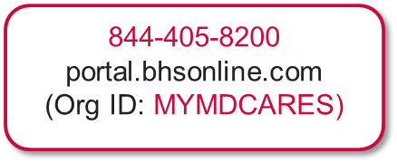
My MD Cares
No-cost, confidential program. No benefit elections necessary.
Provides 24/7 services and resources to active employees and dependents* of State Personnel Management System, Maryland Department of Transportation, Judiciary and Legislature, including all full and part-time employees and contractual
Services include:
  Master's level clinician "care coordinators“
    Short-term counseling- Up to 5 sessions per issue per year
    (no limit on the number of issues)
  Referrals to long-term providers, community resources or other programs
  Free unlimited telephonic financial consultations
  Free 30-minute telephonic or in-office legal consultations
  Dedicated MyMDCARES web portal with locator services, on-demand training, articles, additional resources, easy access
*Interns, Contingent and Temporary employees are not eligible. Not available to Non-SPMS agencies, including the University System, Register of Wills for all Counties, Maryland Stadium Authority, etc.

Slide 17
SPS Benefits System

Slide 18
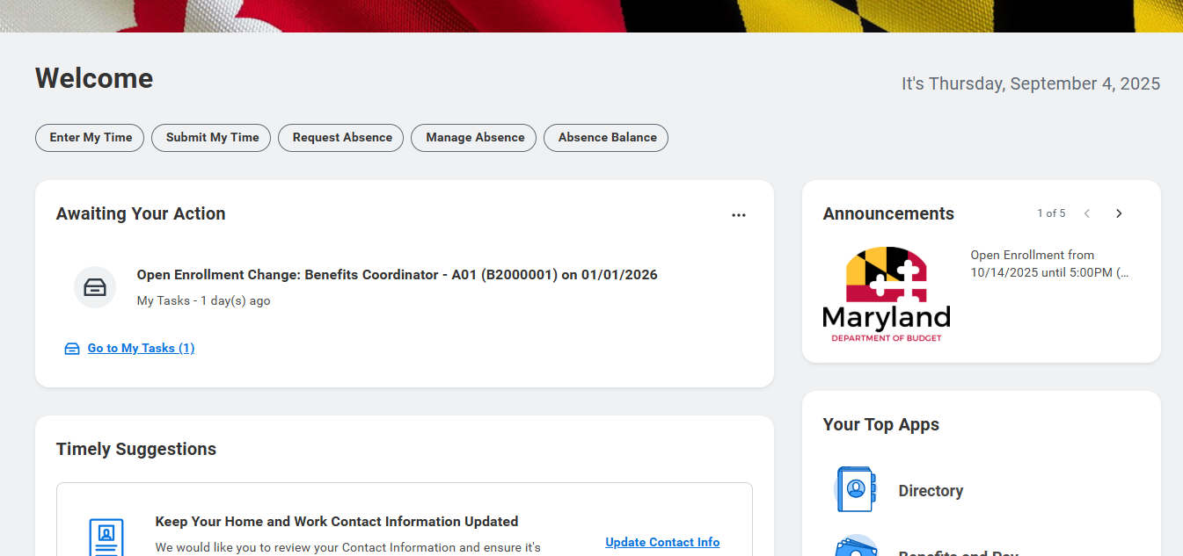
SPS and Open Enrollment
  On the member’s SPS Home Page: Announcements Section is full of OE info

Slide 19
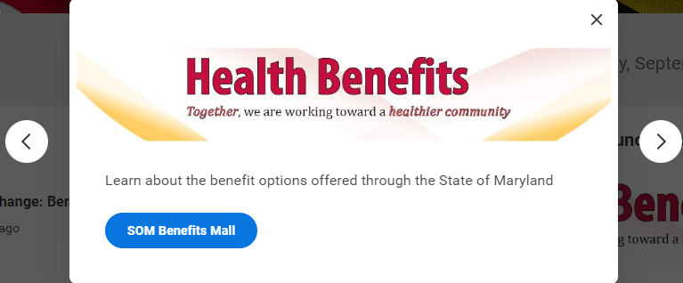
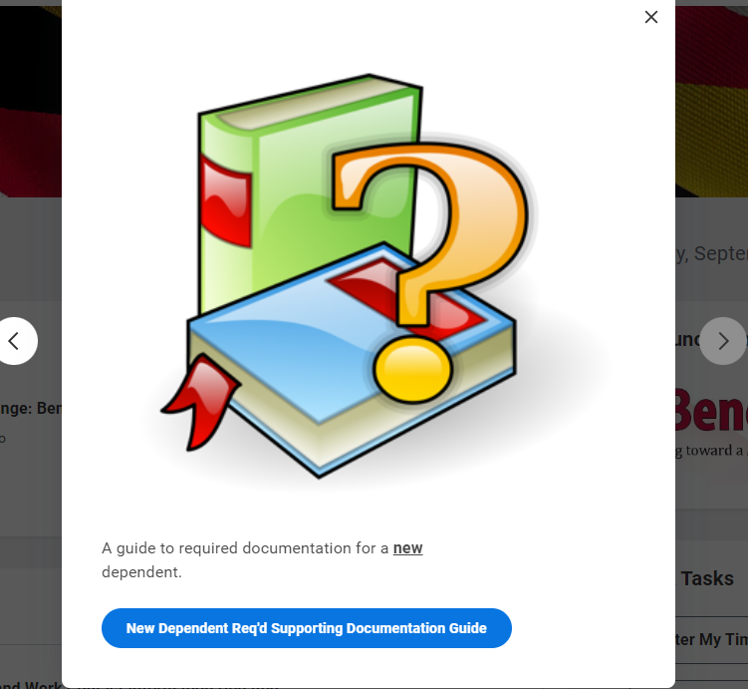
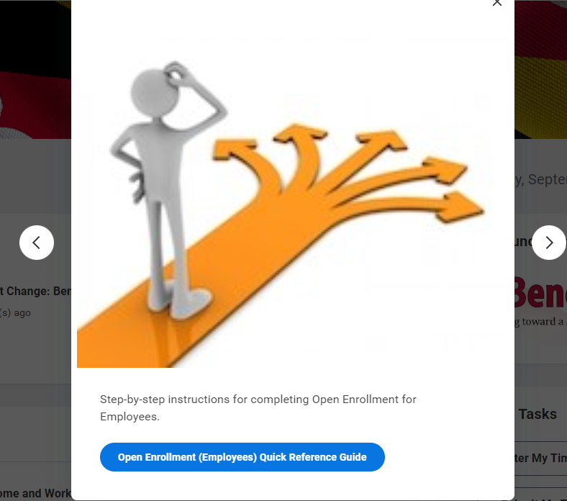
Scroll for Open Enrollment Resources

Slide 20
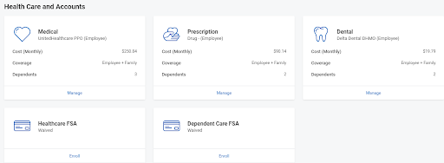
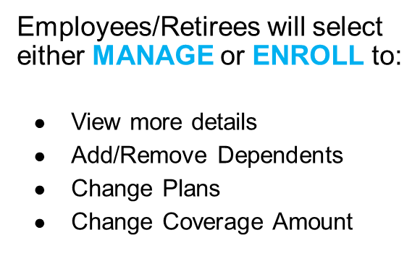
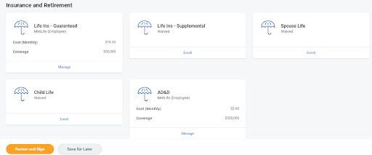
Open Enrollment User-Interface
    The SPS Open Enrollment Event will default to the current employee/retiree elections and dependents except for FSA elections.
After completing elections, select REVIEW AND SIGN to attach new dependent documentation and submit elections

Slide 21
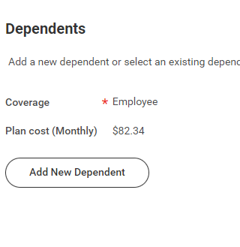
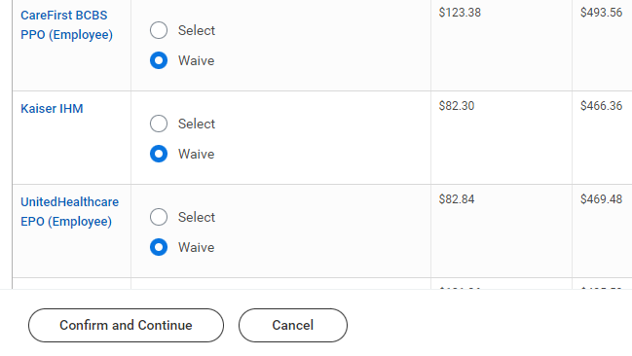
Open Enrollment User-Interface: Selecting Plans

Slide 22

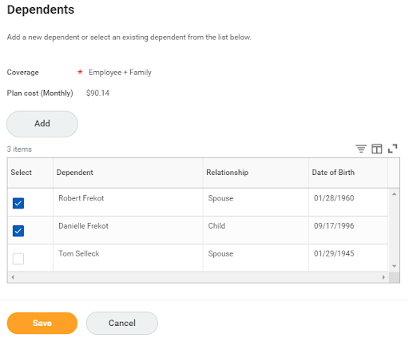
Open Enrollment User-Interface:
Add New Dependents
When changing plans, make sure dependents are checked!
Add new dependents
Add or Remove listed
dependent(s) from coverage
by checking or unchecking.
Dependent not listed? Click the Add button to enter dependent information.

Slide 23
Open Enrollment Events-Special Notes
    Life Events between the 1st day of Open Enrollment and 1/1/2027, will re-open the Open Enrollment events after the employee completes Life Event election
The employee needs to review, complete and submit the re-opened Open Enrollment event to ensure they have the elections they desire for 2027.
ABC’s - Monitor these events to ensure employees are completing the process by continually running the SPS Benefit Open Enrollment Events Report.
Use:
  1. SPS Benefits Open Election Events-Employees and
  2. SPS Benefit Open Enrollment Events-Employees reports to monitor your employees.

Slide 24

Agency Readiness Checklist
Ensure all employees know how to log into SPS Benefits using OneLogin
  -https://stateofmaryland.onelogin.com/
  -Verify all employees have an email address to receive
  EBD OE notifications: Current Work and/or Personal email
Have a communication plan for employees with no email and/or internet access
Be sure employees know they will have to upload the appropriate documentation for newly enrolled dependents AT THE TIME OF ENROLLMENT

Slide 25
Agency Readiness Checklist: Reports
1. SPS Benefit Expiring Contract Report: NOW!
  Contact employees and/or departments to get contract updates for 2027 completed before the 9/25/2026 Shell Record file.
  This gives Contractual Employees the maximum amount of time to make OE elections.
  Remember: employees must have a contract ending no earlier than 1/2/2027 to receive an OE Event.
2. SPS Benefit Open Election Events-Employees Report: before, during and after OE
  Employees with an Open Election Event (new hire, marriage, birth, …) will cause the OE Event to be placed “on hold.”
  Employees cannot access the OE Event until/unless the Open Election Event is submitted or cancelled.
  Follow up frequently…during OE and throughout the year to stay ahead of problems.
3. SPS Benefit Open Enrollment Election Events-Employees Report: ongoing until March 1, 2027
  Remember, Life Events that occur between the 1st day of OE and 1/1/2027 will impact the OE Event.
  The original OE event will automatically rescind and regenerate.
  This causes your employees confusion; you can assist by getting in front of the problem!
  The employee needs to review, complete, and resubmit the re-opened OE Event to ensure their elections are correct.

Slide 26
Contractual Employees

Slide 27

Employee Contracts
  Contractual employees must have an OPEN CONTRACT with an ending date of 1/2/2027 or later to receive their OE Event on 10/19/2026.
SPS Benefit Expiring Contract Report will identify which employees’ contracts have an expiration date prior to 1/2/2027.
Run Report Today

Slide 28
More Employee Contracts…
Benefits Only Agencies should send the January 2027 contracts in the Delta File no later than 9/25/2026, to ensure timely processing into SPS without errors
SPMS and CPBI Agencies should make sure any contracts expiring prior to January 2027, are updated by 10/9/2026
Contracts that start on 1/1/2027 and are for 90 days or less will not meet the eligibility rules for an Open Enrollment event, so please make sure Contract Start Dates and Contract End Dates are accurate for the type and length of employment
  The only exception is employees identified as ACA Eligible for 2027 in the Measurement Period Reporting. These employees need an Active contract on January 1, 2027 and it can be less than 90 days in duration

Slide 29
Contractual Employees: Pre-Tax
Workday-SPS (State Personnel System), SPMS
CPBI Agencies
Judiciary
Maryland Dept of Transportation (MDOT)
Maryland General Assembly
Morgan State University
St. Mary’s College/St. Mary’s Commission
UM Connect (Bowie, Salisbury, Frostburg, Coppin, and U-Baltimore)
PACS-Towson
UMES, UMBI, UMCP, UMCES
UM - Global Campus
UMB
Baltimore City Community College
UMBC
USM

Slide 30
EBD Reminders

Slide 31
Reminders
Benefit Guide
Available online for everyone at DBM.Maryland.gov/benefits
Read the Benefit Guide!
Contacting EBD ebd.mail@maryland.gov
SPS Ticket System
Please refrain from emailing or calling EBD staff directly
ABC’s may complete the Open Enrollment process on behalf of an employee; HOWEVER, a signed enrollment form must be attached to the open enrollment event
Do Not Forget…Open Enrollment closes at 5pm on November 13th!

Slide 32
Retiree Reminders:
For retiring employees:
  Those retiring January 1 must complete a 2027 Retiree Enrollment Form available online at dbm.Maryland.gov/benefits.
  Retirees age 65 or older AND those eligible for Medicare due to disability (at any age), must enroll in Medicare Parts A, B, & D to ensure full medical and prescription drug coverage.
  Medicare eligible dependents of retirees must also enroll in Medicare Part A, B, & D for full coverage.
  Via Benefits can assist in selecting and enrolling in a Part D plan, at 1-855-556-4419.
For current retirees:
  Complete the Open Enrollment Event OR
  Complete the Retiree Enrollment Form mailed to the home address.

Slide 33
Questions?

Slide 34
Thank You!

