Slide 1

The Fundamentals of the Americans with Disabilities Act (ADA), Americans with Disabilities Act Amendments Act (ADAAA) & Reasonable Accommodation Process
Presented by:

Slide 2
WHAT YOU WILL LEARN
This informational session will provide you with fundamental knowledge of the ADA, ADAAA and Reasonable Accommodation process. The following information will be discussed:
History of ADA & ADAAA
Definition of a Disability defined by law
Definition of a Reasonable Accommodation
ADA Coordinator Role
Responsibility of Management
State of Maryland Reasonable Accommodation Request Policy and Procedure
Reasonable Accommodation Process
ADA & COVID 19
Pitfalls and Best Practices
Questions

Slide 3
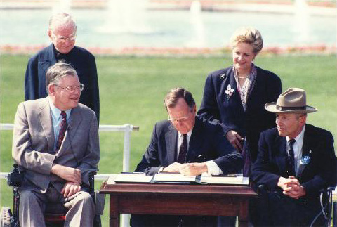
HISTORY OF ADA & ADAAA
The Americans with Disabilities Act (ADA) was signed into law in 1990.
The ADA is a civil rights law that prohibits discrimination against individuals with disabilities in all areas of public life, including jobs, schools, transportation, and all public and private places that are open to the general public.
The ADA guarantees that people with disabilities have the same opportunities as everyone else to participate in the mainstream of American life -- to enjoy employment opportunities, to purchase goods and services, and to participate in State and local government programs and services.
The ADA is divided into five (5) titles that relate to different areas of public life.
Notes:
Bullet I – Signed into law in 1990 by President George H.W. Bush.
Bullet 4- State the meaning of all 5 Titles( Employment), (Public Services in State and Local Government), (Public Accommodations), (Telecommunications) and (Miscellaneous Provisions)

Slide 4
HISTORY OF ADA & ADAAA (Cont.)
Title I (Employment) prohibits employers from discriminating against qualified individuals with disabilities in job application procedures, hiring, firing, advancement, compensation, job training, and other terms, conditions, and privileges of employment.
Requires employers are to provide reasonable accommodations to qualified applicants and employees.
Covers employers with 15 or more employees.
Equal Employment Opportunity Commission (EEOC) is the federal agency that regulates and enforces title I of the law.
The ADA was extended to the Americans with Disabilities Act Amendments Act (ADAAA) in 2008 and became effective on January 1, 2009.
The ADAAA clarifies the definition of disability.
Notes:
Bullet 1 – For this training we will focus on Title I of the ADA – Employment.
Bullet 5/6 – The law broadened the coverage to make it easier for more individuals to establish that they have a disability. Denise, you may want to add more to this talking point…Look up the ADAAA
Title II-State and Local Government
Title III-Public Accommodations
Title IV-Telecommunications and
Title V- Miscellaneous Provisions

Slide 5

WHAT IS A DISABILITY AS DEFINED BY LAW?
A physical or mental impairment that substantially limits one or more major life activity (such as walking, talking, seeing, hearing, or learning).
A person who has a history or record of an impairment (such as cancer that is in remission).
A person who is regarded or perceived by others as having an impairment.
Notes:
Give examples as you go through the bullets. Major life activities also include bodily functions such as bowels, brain, reproductive, respiratory, brain etc.
Bullet 3 –In other words, an impairment that does not limit a major life activity.

Slide 6
WHAT IS A REASONABLE ACCOMMODATION?
Modifications or adjustments to a job application process that enable a qualified applicant with a disability to participate in the hiring process;
Modifications or adjustments to a job or work environment that enable a qualified individual with a disability to perform the essential functions of that position; or
Modifications or adjustments that would enable an employee with a disability to enjoy equal benefits and privileges of employment as are enjoyed by other employees.
Only individuals who have an actual disability, or who have a record of a disability are entitled to accommodations; individuals who are regarded as having a disability are not entitled to accommodations.
Notes:
Talking points: For example, making existing facilities or jobs readily accessible to and usable by persons with disabilities, such as restructuring a job, modifying work schedules, reassigning to a vacant position;
Also, acquiring or modifying equipment or devices, adjusting or modifying examinations, training materials, or policies, and providing qualified readers or interpreters.

Slide 7
EXAMPLES OF REASONABLE
ACCOMMODATIONS
A deaf applicant who needs a sign language interpreter during the job interview.
An employee with diabetes who needs regularly scheduled breaks during the workday to eat a snack and monitor blood sugar and insulin levels.
A blind employee who needs equipment on his/her computer to enlarge the print.
A deaf employee who needs text to speak equipment.
An employee with cancer who needs leave to have radiation or chemotherapy treatments.

Slide 8
ADA COORDINATOR ROLE
Coordinates the interactive process with the employee and designated manager/supervisor during the reasonable accommodation process.
Trains managers, supervisors and employees on the disability laws and reasonable accommodation process.
Administers reasonable accommodations to all qualified employees and job applicants.
Ensures that meeting/conference rooms, lunch rooms and employment test are accessible.
Ensures all agency accessibility requirements are met.

Slide 9
RESPONSIBILITY OF MANAGEMENT
Connects employees and job applicants with the agencies ADA Coordinator for assistance.
Cooperates with the ADA Coordinator and HR during the reasonable accommodation interactive process.
Remains impartial, open-minded and confidential at all times.
Participates in the interactive process and makes accommodation recommendations.
Attends ADA and EEO training.
Do not subject an employee(s) to retaliation due to their request for an accommodation.

Slide 10
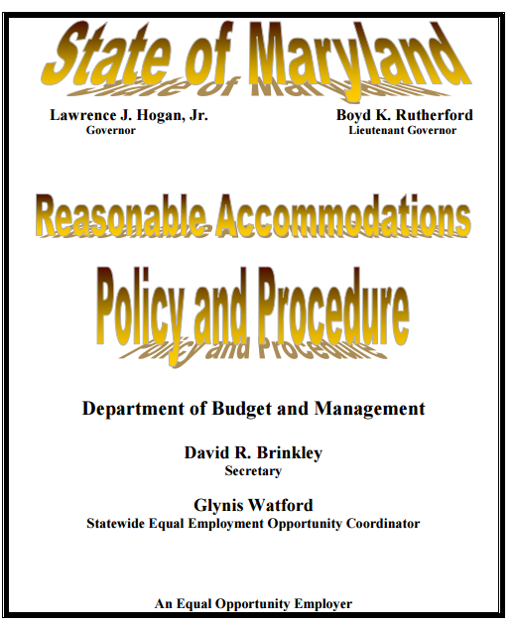
STATE OF MARYLAND REASONABLE ACCOMMODATIONS POLICY AND PROCEDURE

Slide 11

STATE OF MARYLAND
REASONABLE ACCOMMODATIONS POLICY
The State of Maryland is dedicated to full compliance with the reasonable accommodation requirements and the ADA.
No employee shall be retaliated against for seeking a reasonable accommodation for a disability.

Slide 12
REASONABLE ACCOMMODATION
PROCESS
Employees and Applicants may request an accommodation at anytime during employment and the hiring process to the ADA Coordinator, supervisor, manager, Recruitment Rep, or HR.
Accommodation requests do not have to come directly from the employee or applicant. Requests can come from a spouse, parent, physician, job coach, union rep, etc.
Employees may mention to their supervisor or manager challenges they are experiencing while performing their job duties that are related to a medical condition.
Notes:
Talking points: Bullet 4: There are no magic words or formalities. An individual may use "plain English" and need not mention the ADA or use the phrase "reasonable accommodation" when requesting an accommodation. Therefore, any time an employee indicates that he/she is having a problem and the problem is related to a medical condition, the employer should consider whether the employee is making a request for accommodation under the ADA. Give examples.
Also, discuss need for employee to complete the RA Request form. (Informational purposes only.)

Slide 13
REASONABLE ACCOMMODATION
PROCESS (cont.)
The ADA does not indicate a specific time frame for an employer to decide an accommodation request. The law requires the employer to respond to accommodation requests expeditiously.
The decision to grant or deny a reasonable accommodation will be provided to the employee and manager in writing.
The employer is not required to provide the accommodation requested but must provide an accommodation that is reasonable and effective for both the employee and employer.
A confidential ADA file is created for the employee that is separate from the personnel file in Personnel Services.
Notes:
Unreasonable delay in response to a request can result in significant legal consequences.

Slide 14
REASONABLE ACCOMMODATION INTERACTIVE PROCESS
The ADA requires the employer to engage in the interactive process. Failure to do so may result in significant legal consequences.
Gather Information
Explore Accommodation Options
Choose an Accommodation
Implement Accommodation
Monitor Accommodation
Notes:
Talking points:
Gather info: Completion of RA request form; request medical documentation, if needed; meet with employee to determine the problem, limitations that are causing the problem, and needs;
Explore accommodation options: Brainstorm ideas
Choose an accommodation: Select an accommodation that is feasible and effective
Implement accommodation: put selected accommodation in place
Monitor accommodation: follow up with employee

Slide 15
DENIAL OF ACCOMMODATION REQUESTS
Undue Hardships are determined on a case-by-case basis. Factors to consider are:
The nature and net cost of the accommodation needed;
The overall financial resources of the facility or facilities involved in the provision of the reasonable accommodation;
The type of operation or operations of the division;
Whether the accommodation poses a “direct threat” to the health and safety of other employees and other persons associated to the business; and
The impact of the accommodation upon the operation of the facility, including the impact on the ability of other employees to perform their duties and the impact on the facility’s ability to conduct business.
Notes:
An undue hardship occurs when the employer can not find an effective and feasible accommodation that will allow the employee to do the essential functions of their job. Things considered to determine undue hardship are:

Slide 16

ADA AND COVID 19
Covid-19 has changed how we operate in unpreceded ways. Despite such challenges, employers are still required to comply with ADA laws.

Slide 17

ADA AND COVID 19
Some common reasons an employee may request a reasonable accommodation related to COVID-19:
  General fear of contracting COVID-19
  Fear of exposing a vulnerable family member to COVID-19.
  Having an underlying health conditions
  Difficulties with arranging child care
  General fear of potential unsafe work environment
Notes:
As a result of COVID-19 agencies are experiencing an uptick in reasonable accommodation requests to telework as a result of individuals fear of contracting COVID-19.
Not all of the reasons are protected under the ADA. For example: ??? RA request must be for your own ADA qualifying disability.

Slide 18

Some Common Pitfalls
Ignoring a request- this is the same as denying a request.
Making assumptions about the accommodation that is needed.
Sharing an employee’s disability with other employees who do not need to know the information.
Not considering an employee’s need for an accommodation when scheduling training or other work activities.

Slide 19

BEST PRACTICES
Do not predetermine whether or not the condition is a disability.
Focus on the accommodation.
Request medical documentation from qualified medical personnel before providing an accommodation, if needed.
Keep an open mind during the interactive process.
Refer all ADA matters to the ADA Coordinator.
DO NOT RETALIATE!

Slide 20

QUESTIONS

Slide 21
OSEEOC CONTACTS
Glynis Watford
Statewide EEO Coordinator
Glynis.watford@Maryland.gov
410-767-4061
Nicole Webb
Senior EEO Compliance Officer
Nicole.webb@Maryland.gov
410-767-4761
Denise Green
EEO Compliance Officer/EEO Officer
ADA Coordinator (DBM & DO-IT)
Denise.green@Maryland.gov
410-767-1013
Norma Belton
Compliance Coordinator
Norma.belton@Maryland.gov
410-767-4735

Slide 22
REFERENCES
Equal Employment Opportunity Commission
https://www.eeoc.gov/
Department of Budget and Management
http://dbm.maryland.gov/eeo/Pages/EEOHome.aspx
Job Accommodation Network (JAN)
https://askjan.org/

