Slide 1
Benefit Only (Shell) Agency Benefit Coordinator Overview

Slide 2
Session Topics:
Benefits Only/Shell Agency Overview
Review New Employee Notifications
Initial Benefit Enrollment Process
Life Event/Job Change Event Process
Basic Open Enrollment Overview
Benefits Reporting
Troubleshooting
Preventing Delays
Benefits Resources
Notes:
2

Slide 3



SPS Project Timeline/Scope
PHASE 1
PHASE 2
PHASE 3
Implemented:
Workday HCM
Go-Live:
Nov 2014
Audience:
SPMS Agencies
50K + Employees
Implemented:
Workday Time Tracking, Absence Mgmt & Gross Payroll
Go-Live:
March - October 2016
Audience:
SPMS Agencies
50K + Employees
Re-Started:
Workday Benefits Implementation
Go-Live:
January 2019 EEs
May 2019 Retirees
Audience:
Statewide
160K + Employees & Retirees
3

Slide 4
Workday Benefits Functionality
Every employee paid by CPB is required to have a HR record in Workday for Benefits processing
This will not be a full employee record, instead just enough data for Benefits processing
University HR records will be created and maintained via the Shell Record
For Benefit Only/Shell employees, the Benefit Workday system is not the HR system of record
Workday will determine an employee’s benefits eligibility
Workday will generate a benefits enrollment event based on eligibility
Employees and Retirees will log into Workday to complete the event
The employee will initiate life event changes (e.g., birth/adoption, marriage or divorce) in Workday via self-service
Workday Security controls who has access to a person’s data and what they can see/do (e.g., initiation/review/approval of benefits processes)
The Shell file process accept future dated HR events up to 6 days. Typically, future dated transactions are processed on the following Wednesday after comparing with the most recent CPB (RG) Master file.
The Shell file process DOES accept future dated contract records without the aforesaid restrictions.
4

Slide 5
Shell Timeline
Shell files are sent on a bi-weekly basis and loaded every other Friday
Transaction errors from the preliminary processing and workday errors are sent to agencies. Shell master files and contract detail files are also sent to the agencies on Wednesdays.
HR Event occurs in your HR System
Shell Process Prepares Data for Workday
Workday Initiates a Benefit Event*
Shell File Sent Containing HR Event
Shell Process Loads Data into Workday
ABCs Monitor Events With Reports in Workday
* Not all HR events will generate a benefit event. Only HR events that result in a benefit eligibility change.

Slide 6
New Hire Notifications
When an employee is hired, they will receive two separate notifications.
They will receive a notification from Workday indicating that they have a New Hire Benefit event,
They will also receive an Email from OneLogin with their W# and login instructions
Due to the timing of the migration of the new employee to OneLogin, they will most likely receive the New Benefit notification before their W# and Login instructions from OneLogin.

Slide 7
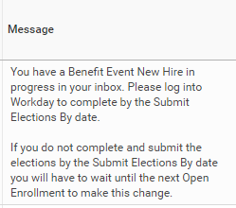

New Hire Workday Benefit Notification
Initiated as soon as the hire is completed in Workday

Slide 8

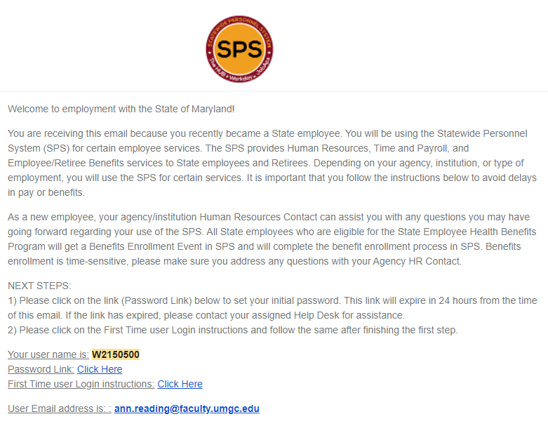
New User OneLogin Notification
Sent after worker migrates to OneLogin. Can take up to 2 hours after hire in Workday.
W2171110
New.user@maryland.gov

Slide 9
HR Events/Updates for Shell Record
HR Events Needed in Shell Record to Administer Benefits Eligibility
Hires
Rehires
Job Changes (Employee Type, Employee Sub-Type, FTE%)
Adding Additional Jobs
Going on/Returning From Unpaid Leave of Absence
Terminations by job
HR Data/Data Changes Needed in Shell Record (refer to Record Layout for all fields)
Date of Birth
Gender
Mailing Address
Contact Information (Home Address, Email, Telephone)
Contract Information (Contract #, Contract Start/End Dates)
9

Slide 10
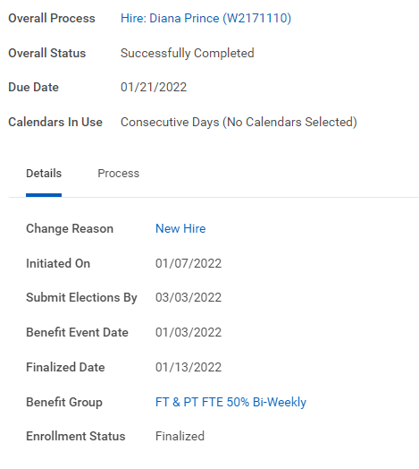
Initial Benefit Enrollment
New Hire Benefit event is initiated as part of HR Hire event from Shell Integration
Event is indicated as a New Hire benefit event.
Employees should attach supporting documents for dependents to expedite EBD approval
Monitor with reports: SPS Benefit Open Election Events – Employees

Slide 11
Initial Benefit Enrollment
New Hire Benefit event is initiated as part of HR Hire event from Shell Integration
Dates:
Initiated On: Date the event was created.
Submit Elections By: Deadline for employee to submit elections and have them approved.
Benefit Event Date: Date qualifying event occurred, in this case it’s the hire date. 60 Days starts from this date.
Finalized Date: Date benefit elections were committed to employee

Slide 12
Initial Benefit Enrollment
New Hire Benefit event is initiated as part of HR Hire event from Shell Integration
Benefit Group for this event.
Common Employee Benefit Groups:
FT & PT FTE 50% Bi-Weekly
FT & PT FTE 50% Bi-Weekly 10 Month
FT & PT FTE 50% Monthly
Contractual (ACA)
Contractual (Non ACA)
Contractuals (No or Less than 90 day Contract)

Slide 13
Initial Benefit Enrollment
New Hire Benefit event is initiated as part of HR Hire event from Shell Integration
Enrollment Status:
Not Started
In Progress
Submitted
Canceled
Rescinded
Finalized

Slide 14
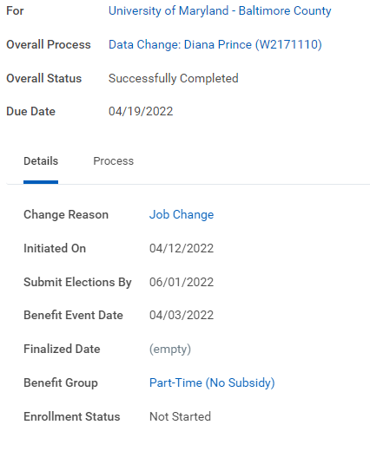
Job Change Events
Job Change Events are kicked off automatically by loaded shell events

Slide 15
Job Change Events
Job Change Events are generated from HR/Data Changes from Shell Record loads.
Most frequent shell changes that can result in a Job Change event:
Contractual ↔ State/Regular
FTE % Change
Pay Frequency
Leave of Absence
Address Change (Kaiser plan only)
Start of Contract and End of Contract events are other events impacted by the shell data.
Monitor with these reports:SPS Benefit Open Election Events - Employees
15

Slide 16

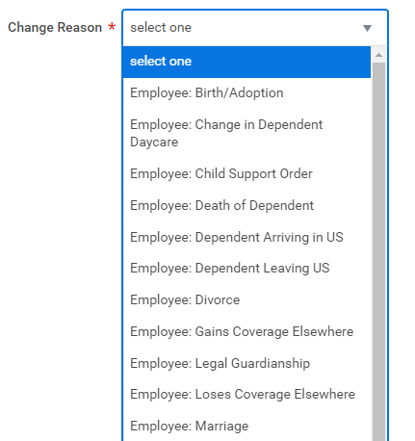
Life Events
Qualifying Life Events are initiated by Employee or ABC
Employees should not use Retiree events
Any Life Event that does not have an attachment will route back to ABC
16

Slide 17
Start and End of Contract Events
Start of Contract Event is an event that runs daily that looks for employees who have gained eligibility based on a new contract.
Event is automatically pushed to the employee
Event date is the contract start date
Employee will have normal 60 days to complete the event
End of Contract process runs on the last day of every month.
Finds contractual employees who are enrolled in benefits and contract end date was in the previous month.
Those without new contract data with a new end date will have benefits terminated on the last day of the prior month. (The month their contract ended)
Example: Employee is enrolled in benefits with the Contractual ACA benefit group. Their contract ends 3/22/2022. On 4/30/2022 End of Contract process will end the employees benefits retroactively to 3/31/2022
Late contracts will cause employee to lose benefits and a ticket will be needed to restore benefits
Monitor with SPS Benefit Expiring Contract Report; SPS Benefit Open Election Events – Employees; IT staff receives Contract detail file from shell process

Slide 18
Open Enrollment Overview
Open Enrollment is open to all eligible employees for a 4 week period every Mid October through Mid November
Important Open Enrollment information
Employees should update their home address in shell record updates prior to Open Enrollment
All data changes should be up to date prior to open enrollment to insure proper eligibility
Contractual employees with contract end dates 1/2 or later will be eligible for an Open Enrollment Event
New dependents need to have proper documentation attached to Open Enrollment event or they will be disenrolled before 1/1
After beginning of OE. Any life or job change event in the current plan year will cancel the OE event and push a new OE event after
OE events initiated after 14 days of OE start will receive automatic 14 day enrollment window
All non FSA elections as of 12/31 will carry over into OE event
As always, FSA must be re-enrolled each year as previous year enrollments will not carry over
Monitor with reports: SPS Benefit Open Enrollment Events – Employees; SPS Benefit New Dependents ABC; SPS Benefit Expiring Contract Report

Slide 19

ABC Reports
SPS Benefit Census Report
SPS Benefit Census Report - FSA only
SPS Benefit Contractuals with Subsidy
SPS Benefit EEs Marked Non-Tenure Track Faculty
SPS Benefit EEs Marked Subsidy Eligible Due to Multiple Contracts
SPS Benefit Expiring Contract Report
SPS Benefit Finalized Election Events – Employees
SPS Benefit Group by Sup Org
SPS Benefit Leave Monitoring Report
SPS Benefit New Dependents ABC
SPS Benefit Open Election Events – Employees
SPS Benefit Open Enrollment Events – Employees
SPS Benefit Shell Record - Active Employees
SPS Benefit Shell Record - Active Employees - Job Detail
SPS Benefit Worker Leave Snapshot

Slide 20
Troubleshooting
Issue | Resolution/Troubleshooting
Employee hire is not in Workday | Make sure the transaction is sent through the shell record process. If it is sent, verify shell record error file through your local IT staff. If the record is in pending status, verify if the effective date is future dated and/or check that the employee is active at CPB.
Event was canceled at 60 days even though it was submitted | Events must be approved within the 60 day window, not just submitted. Account for review and approval time
Open enrollment event was redone after life event and not all elections were merged | If an OE event is completed, a subsequent event can cancel the original OE event and create a second one. Coach employees to review OE events after a job change or life event. Monitor in reports.
Employee has no benefits in SPS | Review employee’s active Status in Workday
Employee has a password or login issue | Employee should contact your agency IT or Help Desk

Slide 21
Troubleshooting
Issue | Resolution/Troubleshooting
Employee has incorrect contact info in SPS | Contact or make change through your HR system and make sure the changes are sent through the Shell Record process for SPS.
Contractual employee doesn’t have an Open Enrollment event | Contractual employees need to have a contract end date of 1/2 or later to receive an OE event
Employee record does not match our HR system | Shell master file and contract detail are sent after every drop to assist your IT team to compare and send the transactions to SPS back correctly; Contact your IT staff before placing a mojo ticket.
Reporting a Shell record issue | Make sure to use the Ben - Shell Integration Issues queue in the Mojo ticketing system. Always consult your local IT staff before placing a ticket in Mojo.

Slide 22
Preventing Delays
Delay or Issue | Tip
Employee doesn’t get all email notifications | Include email address in the shell file for all new employees; verify correct address
Employee SSN is incorrect | Require the SSN card review prior to hire event in your HR system; SSN Changes must be sent through shell files. (refer shell IDD)
Employee doesn’t complete the benefit event on time | Include specifics in your onboarding process and documentation for all timelines for benefit processes; run the ben event reports on a regular basis and contact employees with pending events
Late contract renewals causing benefit cancellations, gaps in coverage, etc. | These can be sent is as future dated events! Get them in early! Make sure it is sent correctly as per the shell IDD

Slide 23
Preventing Delays
Delay or Issue | Tip
Backdated HR events | Add the following to supervisory and manager training-- Impacts from delayed HR events on Employees: Delayed Health Benefits Coverage—employee must pay backdated premiums but may not have had access to services Delayed pre-tax benefit for FSA and Childcare FSA—employee cannot retroactively participate in the FSA, losing pre-tax benefits for that period Different Data in SPS than in Your HR System—any data older than 60 days is sent as an exception, and cannot be older than 6 months; if outside of the 6 month period, the date will be changed in SPS causing confusion for the employee when reviewing info in SPS

Slide 24

SPS Help Center: https://dbm.maryland.gov/sps/Pages/Benefits_HelpCenter.aspx
Shell Record Information Center (Shell IDD): https://dbm.maryland.gov/sps/pages/benefitsshell.aspx
Local Agency IT Staff
SPS Mojo Ticket System: https://spshelp.dbm.md.gov/

